Slide 1
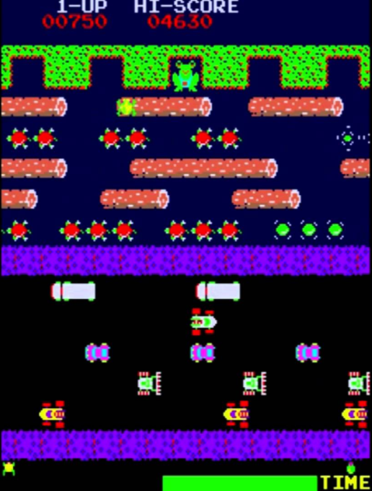
Frogger OOP Project
By Martin Ivanov, Nikola Stanoychev, Radoslav Georgiev and Zlatan Angelov

Slide 2
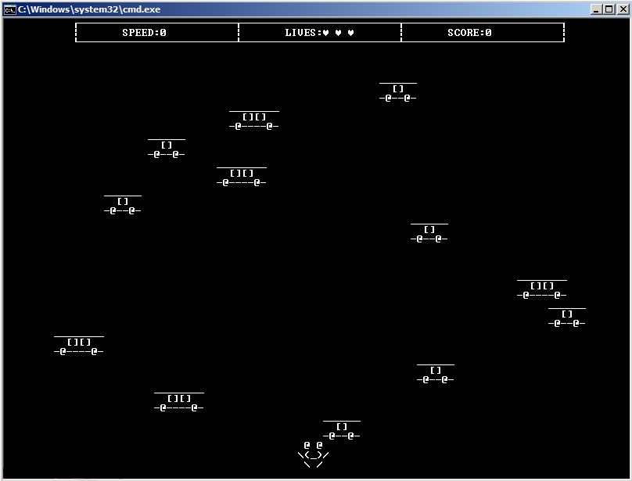
The game of the console

Slide 3
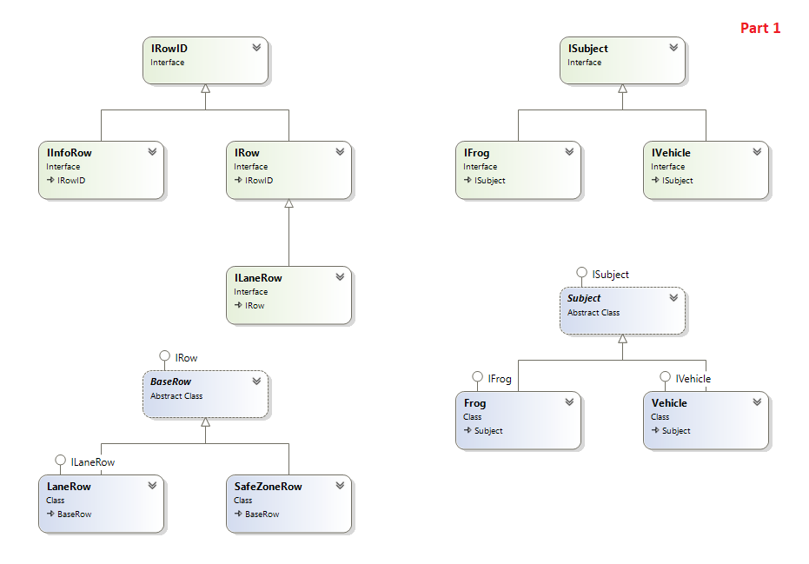
Class Diagram – Part 1

Slide 4
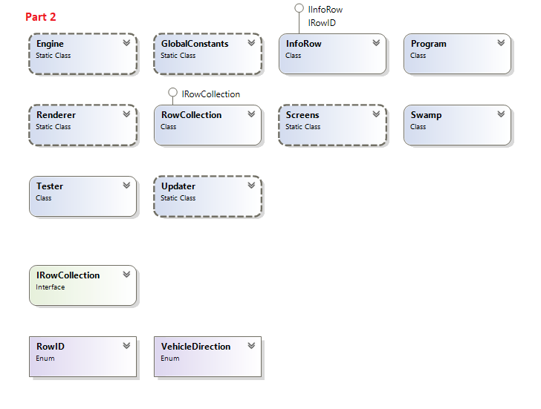
Class Diagram – Part 2

Slide 5
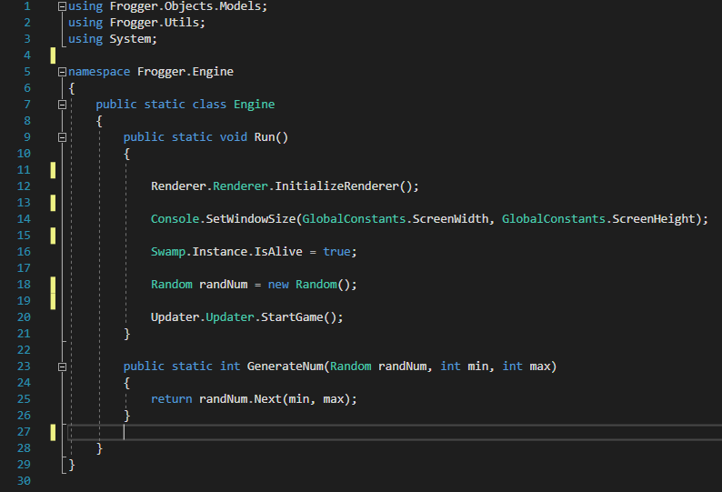
Code Sample: The Engine

Slide 6
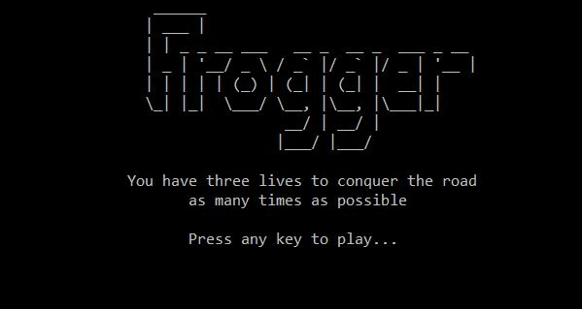
Intro Page from within the game

Slide 7
Questions?

